Slide 1
CSE 260 Digital Logic Design
Registers, Memory
BRAC University

Slide 2
Introduction: Registers
An n-bit register has a group of n flip-flops and some logic gates and is capable of storing n bits of information.
The flip-flops store the information while the gates control when and how new information is transferred into the register.
Some functions of register:
  retrieve data from register
  store/load new data into register (serial or parallel)
  shift the data within register (left or right)
Did you know???
Registers are of 2 types. Memory (or storage) registers and Operational Registers

Slide 3
Simple Registers
No external gates.
Example: A 4-bit register. A new 4-bit data is loaded every clock cycle.
A₃
A₂
A₁
A₀
Q
Q
Q
Q
D
D
D
D
CP
I₃
I₂
I₁
I₀
Did you know???
.A group of flip-flops sensitive to pulse duration is called Latch where as A group of flip-flop sensitive to pulse transition is called Register

Slide 4
Shift Registers
Another function of a register, besides storage, is to provide for data movements.
Each stage (flip-flop) in a shift register represents one bit of storage, and the shifting capability of a register permits the movement of data from stage to stage within the register, or into or out of the register upon application of clock pulses.
Did you know???
Transfer of new information into a register is referred to as Loading the register! If all bits are loaded in a single pulse, we call it Parallel Loading.

Slide 5
Shift Registers
Basic data movement in shift registers (four bits are used for illustration).
Data in
Data out
Data out
Data in
(a) Serial in/shift right/serial out
(b) Serial in/shift left/serial out
Data in
Data in
Data in
Data out
Data out
(c) Parallel in/serial out
(d) Serial in/parallel out
Data out
(e) Parallel in / parallel out
(f) Rotate right
(g) Rotate left

Slide 6
Serial Shift Register
Parallel Shift Register
One bit is shifted at a time
Slower
Less hardware
Control single is enabled/maintained for a period equal to 1 word time
All data transferred in a single pulse
Faster
More hardware
Control signal enabled during a single clock pulse
Did you know?
Bit-time: Time interval between clock pulses
Word time: Time required to shift entire content of a shift register
Counters

Slide 7
Type 1: Serial In/Serial Out Shift Registers
Accepts data serially – one bit at a time – and also produces output serially.
Serial data input
Q₀
Q₁
Q₂
Q₃
Serial data output
D
Q
D
Q
D
Q
D
Q
C
C
C
C
CLK

Slide 8
Serial In/Serial Out Shift Registers
Application: Serial transfer of data from one register to another.
SI
SO
SI
SO
Shift register A
Shift register B
Clock
CP
Shift control
Clock
Shift control
Wordtime
CP
T₁
T₂
T₃
T₄
Counters

Slide 9
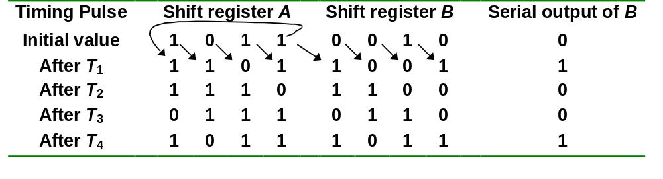
Serial In/Serial Out Shift Registers
Serial-transfer example.

Slide 10
Type 2: Serial In/Parallel Out Shift Registers
Accepts data serially.
Outputs of all stages are available simultaneously.
Data input
D
SRG 4
Logic symbol
CLK
C
Q₀
Q₁
Q₂
Q₃

Slide 11
Serial In/Parallel Out Shift Registers
Accepts data serially.
Outputs of all stages are available simultaneously.
Data input
D
Q
D
Q
D
Q
D
Q
C
C
C
C
CLK
Q₀
Q₁
Q₂
Q₃
Data input
D
SRG 4
Logic symbol
CLK
C
Q₀
Q₁
Q₂
Q₃
Counters

Slide 12
Parallel In/Serial Out Shift Registers
Bits are entered simultaneously, but output is serial.
Data in
D₀
D₁
D₂
D₃
SHIFT/LOAD
SRG 4
Serial data out
CLK
C
Logic symbol

Slide 13
Type 3: Parallel In/Serial Out Shift Registers
Bits are entered simultaneously, but output is serial.
Data input
D₀
D₁
D₂
D₃
SHIFT/LOAD
Serial data out
D
Q
Q₀
D
Q
Q₁
D
Q
Q₂
D
Q
Q₃
C
C
C
C
CLK
????

Slide 14
Parallel In/Serial Out Shift Registers
Bits are entered simultaneously, but output is serial.
Data input
D₀
D₁
D₂
D₃
SHIFT/LOAD
Serial data out
D
Q
Q₀
D
Q
Q₁
D
Q
Q₂
D
Q
Q₃
C
C
C
C
CLK
SHIFT.Q₀ + SHIFT'.D₁
Counters

Slide 15
Bidirectional Shift Registers
Data can be shifted either left or right, using a control line RIGHT/LEFT (or simply RIGHT) to indicate the direction.
RIGHT/LEFT
Serial data in
RIGHT.Q₀ + RIGHT'.Q₂
D
Q
D
Q
D
Q
D
Q
Q₃
Q₁
Q₂
C
C
C
C
Q₀
CLK

Slide 16
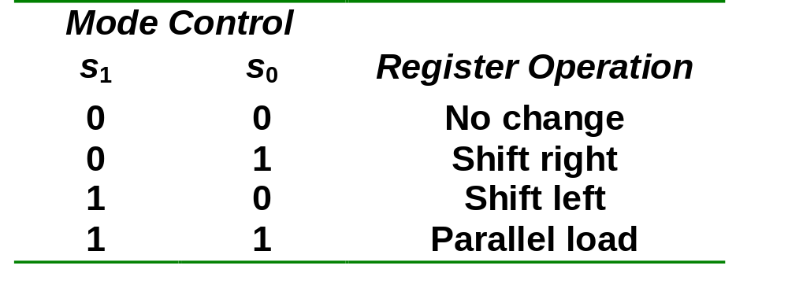
Bidirectional Shift Registers
4-bit bidirectional shift register with parallel load.

Slide 17
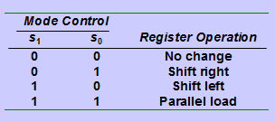
Bidirectional Shift Registers
4-bit bidirectional shift register with parallel load.
Parallel outputs
A₄
A₃
A₂
A₁
Clear
Q
Q
Q
Q
D
D
D
D
CLK
s₁
4x1 MUX
4x1 MUX
4x1 MUX
4x1 MUX
s₀
3 2 1 0
3 2 1 0
3 2 1 0
3 2 1 0
Serial input for shift-right
Serial input for shift-left
I₄
I₃
I₂
I₁
Parallel inputs

Slide 18
An Application – Serial Addition
(Self Study)
Most operations in digital computers are done in parallel. Serial operations are slower but require less equipment.
A serial adder is shown below. A ← A + B.
SI
Shift-right
SO
Shift-register A
x
y
z
FA
S
C
CP
SI
External input
SO
Shift-register B
Q
D
Clear

Slide 19
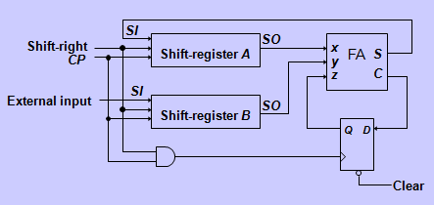
An Application – Serial Addition
A = 0100; B = 0111. A + B = 1011 is stored in A after 4 clock pulses.
Initial:
A: 0 1 0 0
B: 0 1 1 1
Q: 0
Step 1: 0 + 1 + 0
S = 1, C = 0
A: 1 0 1 0
B: x 0 1 1
Q: 0
Step 2: 0 + 1 + 0
S = 1, C = 0
A: 1 1 0 1
B: x x 0 1
Q: 0
Step 3: 1 + 1 + 0
S = 0, C = 1
A: 0 1 1 0
B: x x x 0
Q: 1
Step 4: 0 + 0 + 1
S = 1, C = 0
A: 1 0 1 1
B: x x x x
Q: 0

Slide 20
Practice time
Design a serial adder using sequential logic only (No full adder is allowed to be used)
Counters

Slide 21

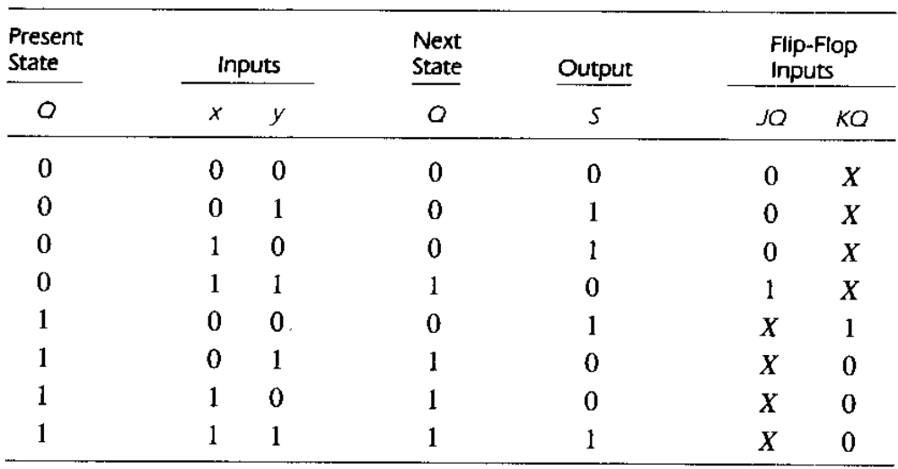
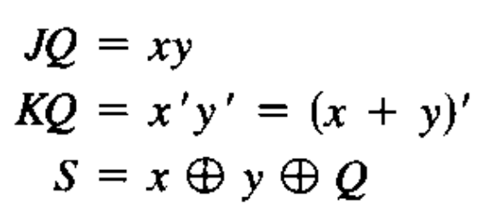
Solution
/Cin
/Cout
Counters

Slide 22
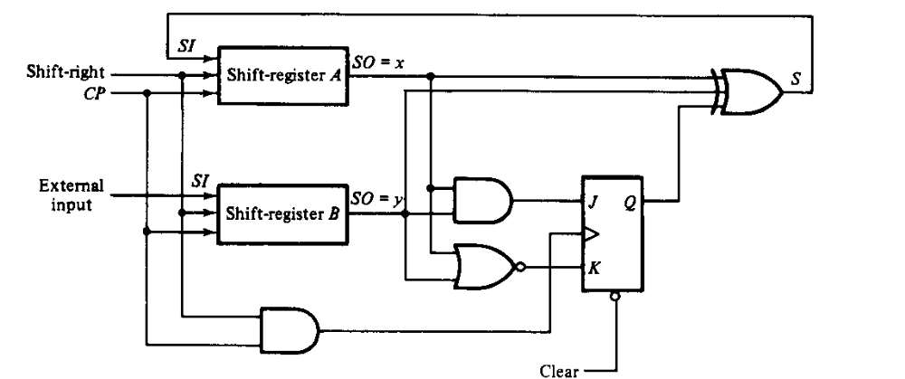
Solution
Counters

